Slide 1

EMPLOYEE MANAGEMENT ON THE TELEVISION «REYDI»
Students: Shynybayeva Adilya Orazaly Merey
Faculty of Information Technology Media Technologies
Astana IT University, Nur-Sultan, Kazakhstan
Group: MT-2004
Supervisor: Yerasyl Amanbek, Lecturer
March, 2021

Slide 2

・ Introduction
・ UML Diagram
Outline
・ Conclusion
・ Glossary
2

Slide 3
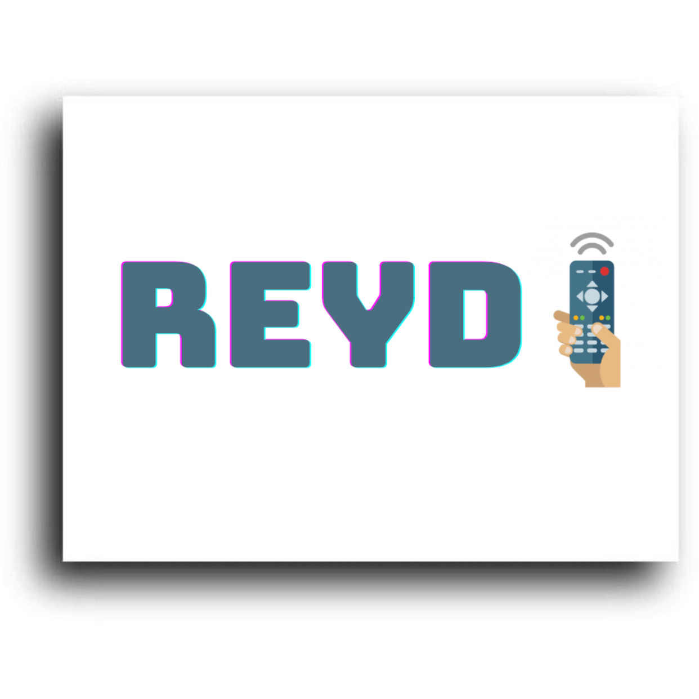


Introduction
The purpose of the project:
To track and control activities of employees
The advantages of the project:
To store and access information
Updating information
Making requires
The users of the program:
A director
An administration department
Figure 1. The logo (meREY + aDIlya)
3
Notes:
, making requires knowing about their projects and so on.

Slide 4
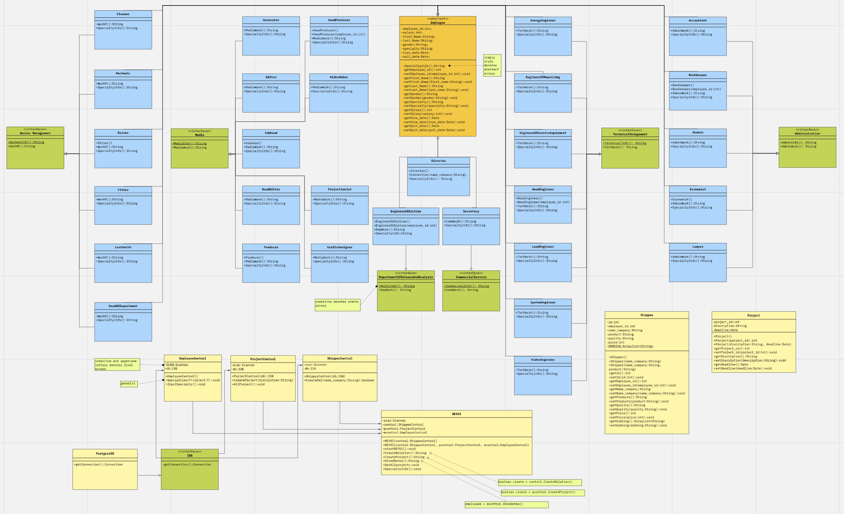
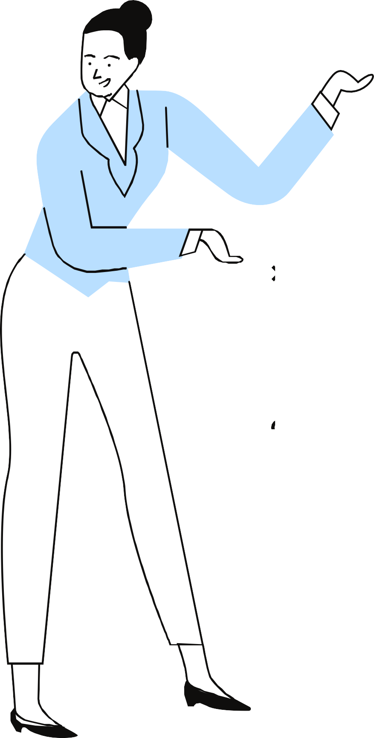
UML Diagram
(https://miro.com/app/board/o9J_lQl_y-Q=/)

Slide 5
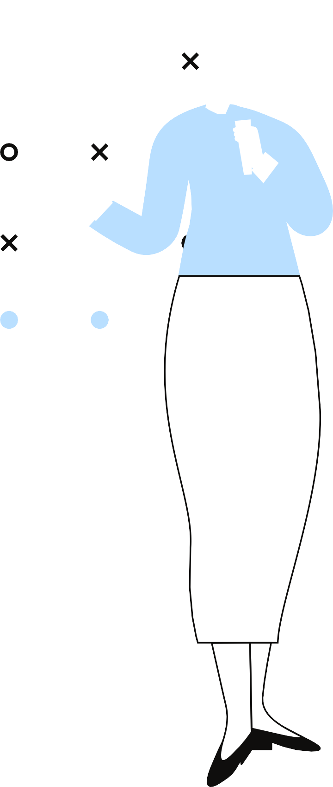
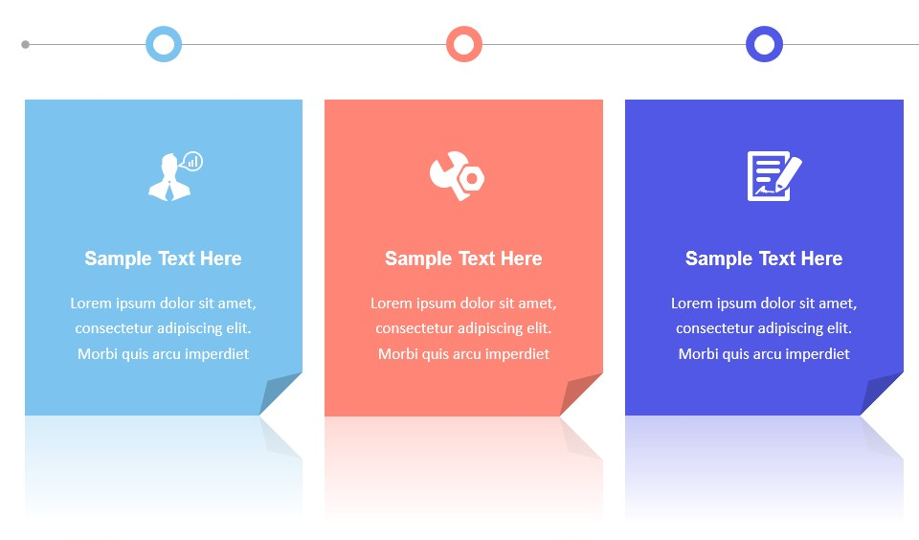
Conclusion
Validation of database
List of weaknesses
List of potential future upgrades
keeps a really good control all information about employees
small and limited data
add more data about employees
provides a security
add more departments
corresponds to user requirements
connect our television to others
5

Slide 6




Glossary(1/4)
A
Abstract class – a restricted class that cannot be used to create objects (to access it, it must be inherited from another class).
Abstract method – can only be used in an abstract class, and it does not have a body. The body is provided by the subclass (inherited from).
D
Dependency Inversion Principle – states that the high-level module must not depend on the low-level module, but they should depend on abstractions. It should be possible to change an implementation easily without altering high-level code
E
Exception handling – If an exception occurs within the try block, it is thrown. Code can catch this exception (using catch block). To manually throw an exception, we use the keyword throw. Any code that absolutely must be executed after a try block completes is put in a finally block.
Encapsulation – a mechanism of wrapping the data (variables) and code acting on the data (methods) together as a single unit. In encapsulation, the variables of a class will be hidden from other classes and can be accessed only through the methods of their current class. Therefore, it is also known as data hiding (declare the variables of a class as private, provide public setter and getter methods to modify and view the variables values).
6

Slide 7
Glossary(2/4)
G
Generics – means parameterized types. The idea is to allow type (Integer, String...and user-defined types) to be a parameter to methods, classes, and interfaces. Using Generics, it is possible to create classes that work with different data types.
Graphics – provides the capabilities of drawing on the screen. In Java, custom painting is done via the java.awt.Graphics class, which manages a graphics context, and provides a set of device-independent methods for drawing texts, figures and images on the screen on different platforms.
I
Interface – a completely "abstract class" that is used to group related methods with empty bodies. To access the interface methods, the interface must be "implemented" by another class with the implements keyword.
Inheritance – a mechanism in which one object acquires all the properties and behaviors of a parent object.
Interface Segregation Principle – states that no client should be forced to depend on methods it does not use. ISP splits interfaces that are very large into smaller and more specific ones so that clients will only have to know about the methods that are of interest to them.
7

Slide 8
Glossary(3/4)
J
JDBC(Java Database Connectivity ) – is the Java API that manages connecting to a database, issuing queries and commands, and handling result sets obtained from the database.
L
Liskov’s Substitution Principle – parent class should not be easily substituted with their child classes without blowing up the application. Code should never have to check which sub-type it’s dealing with.
O
Overriding – child class has the same method as declared in the parent class.
P
Polymorphism – means "many forms", and it occurs when we have many classes that are related to each other by inheritance. Polymorphism uses methods to perform different tasks. This allows us to perform a single action in different ways.
8

Slide 9
Glossary(4/4)
S
Swing – a library to make GUI(Graphical User Interface) components for Java applications.
Single Responsibility Principle – each class has a single purpose. All its methods should relate to function.
U
Upcasting – is casting of a child object to a parent object, in simple words casting individual type to one common type.
9

Slide 10

Thank you for your attention!
JAVA
SQL

